Slide 1



AndroVM
an alternative to Android SDK emulator
SEMINAIRE
Châteaux de la Volonière
Présentation GENYMOBILE
13th October, 2012

Slide 2
Agenda
FORMATION
Android Open Source Project
Presentation
Architecture
Building/Testing
Contribution
AndroVM project
Presentation
Usage
Architecture
We need your help !

Slide 3


Android Open Source Project [AOSP]
FORMATION
Initiative from the Open Handset Alliance, leaded by Google, to create an open mobile platform for telcos, OEMs and developers.
« Open Source » project : mainly under ASL 2.0 licence (GPL for the Linux kernel and some components), but strong dependency to Google (Honeycomb traumatism…), no shared roadmap, no community development
Ten major releases (1.0, 1.1, CupCake, Donut, Eclair, Froyo, Gingerbread, Honeycomb, ICS, JB) since September 2008
Some numbers: more than 450M devices and >1.2M activations a day

Slide 4
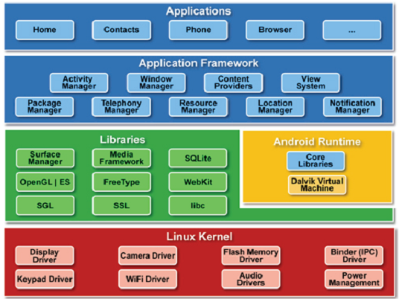
Android – General architecture
FORMATION

Slide 5
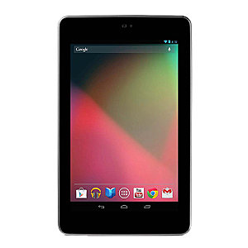
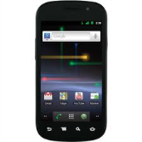

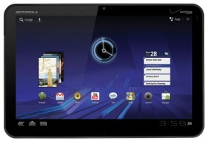
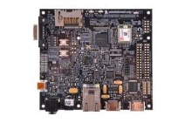
Jelly Bean – Devices support
FORMATION
The last release of AOSP (Jelly Bean/4.1) supports :
Nexus S (GSM, CDMA/WiMAX)
Galaxy Nexus (GSM/HSDPA+, CDMA/LTE)
Nexus 7
Motorola Xoom (WiFi only, CDMA/LTE)
PandaBoard (development board)
But, even for those, some components are only available in binary form (radio, OpenGL/graphics, WiFi, …), some other are even not publicly available (rotation sensor, camera, …)
http://source.android.com/source/building-devices.html
https://plus.google.com/112218872649456413744/posts/75aLL1dWY2u

Slide 6




AOSP – Source code interests
FORMATION
« ROM Cooking » on smartphones and tablets (ex : CyanogenMod project – more than 1M devices)
Use of Android on new platforms, different from smartphones and tablets
Application debugging and optimization
Source code security analysis

Slide 7

AOSP JB – Building
FORMATION
One information source : http://source.android.com
OS pre-requisite : http://source.android.com/source/initializing.html
My advice : use a 64-bit Ubuntu 10.04 (reference platform) [Ubuntu 12.04 support announced for next major relerase]
Source code: >8.5GB
Building system: 4GB RAM minimum (16GB better), 25GB free storage minimum (90GB to build all ‘targets’)
Setup / repo tool :
$ mkdir ~/bin
$ PATH=~/bin:$PATH
$ curl https://dl-ssl.google.com/dl/googlesource/git-repo/repo > ~/bin/repo
$ chmod a+x ~/bin/repo
http://source.android.com/source/initializing.html
http://source.android.com/source/downloading.html

Slide 8
AOSP JB – Building
FORMATION
Source code download :
$ mkdir android-4.1.2
$ repo init -u https://android.googlesource.com/platform/manifest -b android-4.1.2
$ repo sync
Target selection and building:
$ source build/envsetup.sh
$ lunch (select target)
$ make –jX (where X is the number of parallel compilation processes)
→ A complete build can take from 20 minutes to 8 hours depending on the building system configuration… (JBQ’s host : Dual Xeon E5620 Quad-core, 24GB RAM →30 minutes to build ICS for the Galaxy Nexus).
Last step : ROM install on device, or execution using the emulator or a virtual machine.
http://source.android.com/source/downloading.html
http://source.android.com/source/building.html

Slide 9
AOSP – Source code structure
FORMATION
bionic/ : « libc » replacement
bootable/ : reference bootloader
build/ : AOSP build scripts
cts/ : « Compatibility Test Suite »
dalvik/ : Dalvik virtual machine
development/ : Development tools
device/ : Device specific files
docs/ : source.android.com source files
external/ : External projects used by AOSP
frameworks/ : System services, android.* JAVA classes, …
hardware/ : Hardware support libraries
libcore/ : « Apache Harmony » project
ndk/ : Native Development Kit
packages/ : Basic Android applications and services
prebuilt/ prebuits/: Precompiled binaries
sdk/ : Software Development Kit
system/ : System components

Slide 10

AOSP – CTS/CDD
FORMATION
CDD = Compatibility Definition Document
Android devices specifications (one CDD for each Android version).
A required condition (but not enough…) to get access to the Google Market/Play is that the device respect the Android version CDD.
Pre-requisites can dramatically change from one version to an other. For example, the ICS CDD requires 340MB available RAM (after Linux kernel boots, not counting RAM used by video, radio, …) whereas the Gingerbread CDD only required 128MB available RAM.
http://source.android.com/compatibility/overview.html

Slide 11
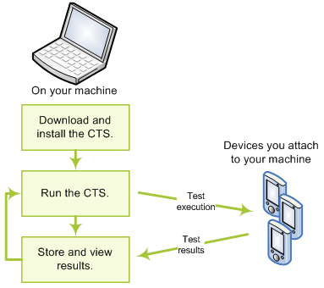
AOSP – CTS/CDD
FORMATION
CTS = Compatibility Test Suite
Testing tools used to (partly) check the conformity of a device (and its Android ROM) towards the target CDD.
http://source.android.com/compatibility/cts-intro.html

Slide 12
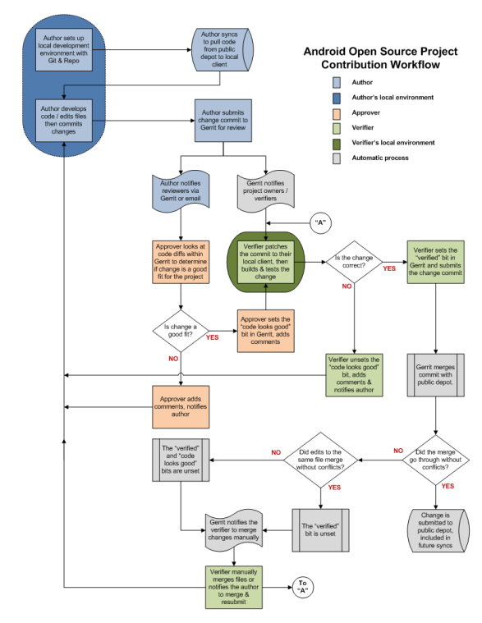
AOSP – Contribution
FORMATION
Everybody can contribute code to Android, but…
Every contribution is subject to Google’s validation :
Code quality : Android « code style guidelines »
Functional code
Strategic/Politic ?
Same function/piece of code may be developed
at same time by Google…
Tool based on Gerrit
Service unavailable during >6 months in 2011…
http://source.android.com/source/submit-patches.html
https://android-review.googlesource.com

Slide 13

AndroVM - Introduction
FORMATION
An initiative from Genymobile (French start-up 100% focused on Android).
Rename of the “Buildroid” project
Objectives :
Provide functional and robust Android Virtual images
Environment : until now mainly focused on VirtualBox, but images are running well on VMWare (minus some functions)
http://www.androvm.org/

Slide 14

AndroVM – AOSP porting to VirtualBox
FORMATION
Beginning with ICS, AOSP includes a « VirtualBox target » ☺
But many functions were missing ☹ :
No mouse
No network
No Audio
No OpenGL ES 2.0
No USB support
→ That’s how come the idea to work on VirtualBox support in AOSP…
http://www.buildroid.org/blog/?page_id=38

Slide 15
AndroVM – AOSP porting to VirtualBox
FORMATION
Functions developed:
Mouse support: Kernel recompilation with the good option
Ethernet support : Startup scripts modifications
RTC (Real-Time Clock) support : Android Alarm modification to run correctly on x86 platforms
Power Management support : Add specific support for VirtualBox in the Power Management library
Audio support :
Kernel recompilation with ALSA support
New Audio Hardware module (ICS)
Porting of the « Nexus 7) Audio Hardware module to support VirtualBox (JB)
File sharing with the host :
VirtualBox kernel modules compiling
Startup scripts modifications

Slide 16
AndroVM – AOSP porting to VirtualBox
FORMATION
Functions developed:
USB support :
Kernel recompilation with USB host and mass-storage driver
« vold » component configuration to add USB storage automatic mounting
WiFi emulation : wpa_supplicant modifications to emulate a WiFi connection based on the virtual Ethernet card
OpenGL ES 2.0 Hardware support : Modification of the “OpenGL translation support” written by Google for the emulator
AndroVM configuration tool : Small Android application used to configure the VM settings (screen size, keyboard emulation, …)

Slide 17
AndroVM – ARM support
FORMATION
Problem with Android running on x86 : some applications (most games) run native ARM code.
Intel introduces an x86 Atom-based smartphone with the capability to run ARM code using “ARM translation” with very good performance !
Unfortunately no source code available… ☹
Got a phone, Reverse-engineered the “houdini” libraries implementing “ARM translation”, Integrated them in AndroVM and it worked ☺
Now, AndroVM and android-x86 images can run native ARM code.
http://androvm.org/blog/ex-buildroid/2012/06/11/running-arm-apps/
http://androvm.org/blog/ex-buildroid/2012/06/18/using-arm-emulation-on-other-android-x86-distributions/

Slide 18
AndroVM – Why ? Usage ?
FORMATION
From “pure technical interest” to usage…
>15000 VM downloads (Buildroid/AndroVM)
Developers replacing the SDK emulator
Performance issues : qemu-based emulator running ARM images ; option to run KVM-based x86 images
OpenGL issues : software-only OpenGL ; option to use Hardware acceleration (AndroVM uses the same component)
User-friendly : AndroVM seems easier to use than the SDK emulator
People wanting to run Android applications on their x86 systems

Slide 19
AndroVM
FORMATION
DEMO

Slide 20
AndroVM – More to come
FORMATION
We’re currently working on :
An AndroVM management tool : create/modify VM, start/stop them, automatically connect adb, ...
Sensors emulation : either manual or using input data from USB-connected Android device
What could be next :
Multi-touch emulation
Bluetooth emulation
NFC emulation

Slide 21
AndroVM – We need your help !
FORMATION
Android developers, please help us make your life easier ☺
From “pure technical interest” to usage…
Do you feel the need of an alternative to the Android SDK emulator ?
Are you able to use HAXM and Hardware OpenGL or is it impossible to use in your environment ?
What functions would you need the most ? Bluetooth ? NFC ? WiFi-Direct ?...
Are you able to test your apps with variable network quality/reliability ? Do you feel the need for it ?
→ dan@androvm.org

Slide 22
Links
FORMATION
AOSP building instructions: http://source.android.com
Android Google groups:
http://groups.google.com/group/android-building
http://groups.google.com/group/android-porting
http://groups.google.com/group/android-platform
http://groups.google.com/group/android-kernel
xda-developers forum :
http://forum.xda-developers.com/forumdisplay.php?f=564
Cyanogenmod forum : http://forum.cyanogenmod.com
android-x86 project : http://www.android-x86.org
AndroVM project : http://www.androvm.org/

Slide 23
Questions ?
SEMINAIRE
Châteaux de la Volonière
Présentation GENYMOBILE

Slide 24

MERCI !
SEMINAIRE
Châteaux de la Volonière
Présentation GENYMOBILE
Daniel Fages
dan@androvm.org
dfages@genymobile.com

